Slide 1
BTEC IT Single & Double @ GAD P16

Slide 2
Courses
BTEC IT Extended Certificate
BTEC IT Diploma
‘Single’
1 ALevel Equivalent
10 hours per fortnight
2 Exams
2 Coursework Projects
‘Double’
2 ALevel Equivalent
20 hours per fortnight
3 Exams
5 Coursework Projects

Slide 3
Important
If you want to do Double IT, you have to pick Single IT as an option as well

Slide 4
Future…
The study of IT particularly encourages development of research and analysis skills, project management and prioritising, effective communications, the practical skills of adapting and integrating, and the evaluation skills of assessing, interpreting and validating.
For progression to an apprenticeship, for example:
Computing
IT
Engineering
Business Management
For progression to a degree course, for example:
BSc (Hons) in Computer Animation
BSc (Hons) in Digital Media
BSc (Hons) in Web Technologies
BSc (Hons) in Information Systems

Slide 5
Course Breakdown
Single & Double
Double ONLY
Year 12
Unit 1 – Information Technology Systems (E)
Unit 2 – Creating systems to manage information (E)
Year 13
Unit 3 – Social media for business (CW)
Unit 6 – Website Development (CW)
Year 12
Unit 4 – Programming (CW)
Unit 11 – Cyber Security (E)
Year 13
Unit 7 – Mobile App Development (CW)
Unit 9 – Project Management (CW)

Slide 6
Exam Timetable
Exams:
JUNE Y12
Unit 1 – Information Technology Systems (E)
Unit 2 – Creating systems to manage information (E)
Unit 11 – Cyber Security (E)
JAN Y13
Unit 1/2/11 Resits if required
JUNE Y13
Unit 1/2/11 Resits if required

Slide 7
Single

Slide 8
Double

Slide 9
Exam Unit Overview
Unit 1 – Information Technology Systems (E)
Written exam, explores the relationships between hardware and software that form an IT system. How we create them and what they are made up of.
Unit 2 – Creating systems to manage information (E)
On screen practical exam, based around databases, focuses on how to build a system to manage, process and store data effectively.
Unit 11 – Cyber Security (E)
Written exam, explores cyber security threats and vulnerabilities, the methods used to protect systems against threats and how to plan for and manage security incidents.

Slide 10
Coursework Unit Overview
Unit 3 – Social Media for Business (CW)
How businesses use social media to promote their products & services and implement social media activities in a business to meet requirements.
Unit 6 – Website Development (CW)
Investigate website development principles before designing and developing a website using scripting languages.
Unit 4 – Programming (CW)
Learn the underpinning concepts and implications of programming languages to design, develop and test computer programs.
Unit 7 – Mobile App Development (CW)
Investigate mobile apps and design and develop an application intended for use on mobile devices, either iOS or Android.
Unit 9 – IT Project Management (CW)
Investigate a range of project management principles and methodologies and undertake the management of a ‘live’ or ‘simulated’ IT project from start to finish (Unit 7)

Slide 11
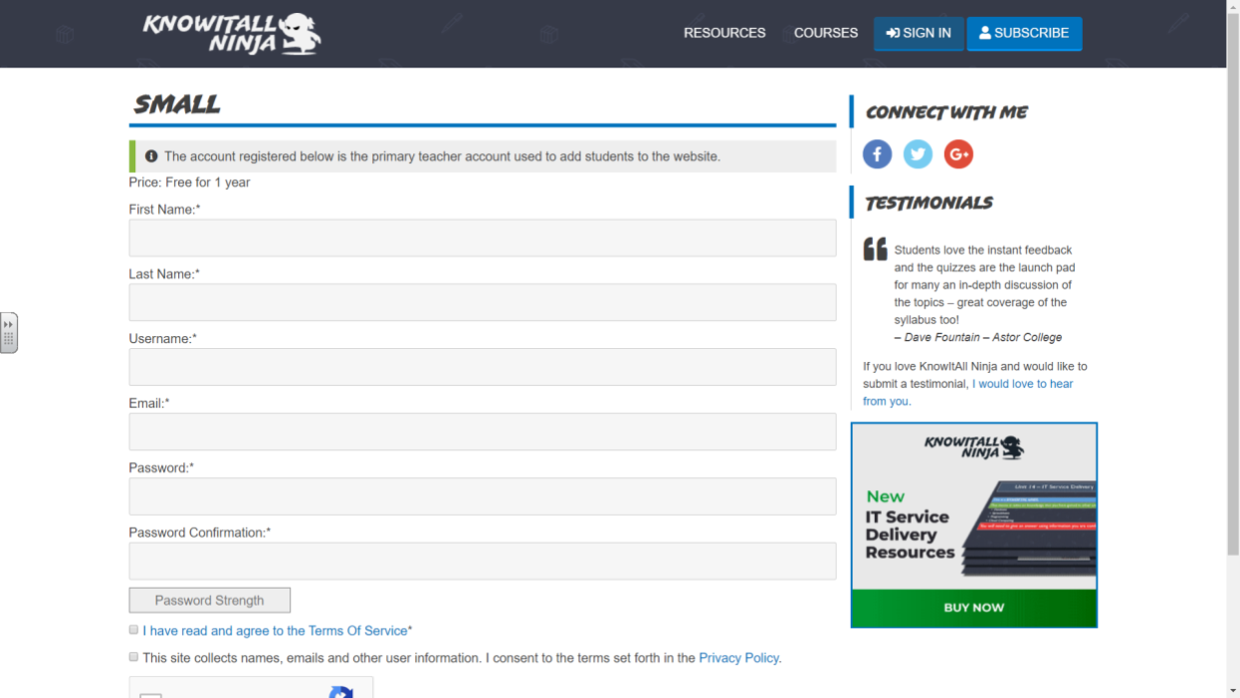
https://www.knowitallninja.com/register/small/?ca=fce2cb8e71af128a66b7d698061921b3
Register for the site
• You must enter your real Forename and Surname.
• Username must be your initial of your Forename,
followed by your Surname. EG: Jpountney
• Email: Use your GAD AC email address. (its AC0300XXXX@darlaston.graceacademy.org.uk)
• Password: Set yourself a password you will remember!
Select ‘Courses’ from the menu bar at the top of the page
Select ‘Information Technology Systems’ (This is Unit 1)
Select ‘Click to Start this Course’

Slide 12
Get in touch
Mr Pountney
0048
jpountney@darlaston.graceacademy.org.uk

