Slide 1
Health and Social Care
Taster session

Slide 2
Health and Social Care Overview
Units in the course
Assessment 52% of exams - Unit 1 – Human Lifespan Development and unit 2 - Working in Health and Social care
48% coursework - Unit 5 - Meeting individual care and support needs and Unit 12 - Supporting individuals with additional needs
When do exams happen?
Exam unit will be sat in the June of year 12 and Jan and June of year 11. Your best grade will count. (You will have three attempts to earn the best grade)
Unit 5 and 12 will be internally assessed and externally moderated in year 13.

Slide 3
What is Health and Social Care?
What do you think Health and Social care is? Write it around the brainstorm below.
What is HSC?

Slide 4
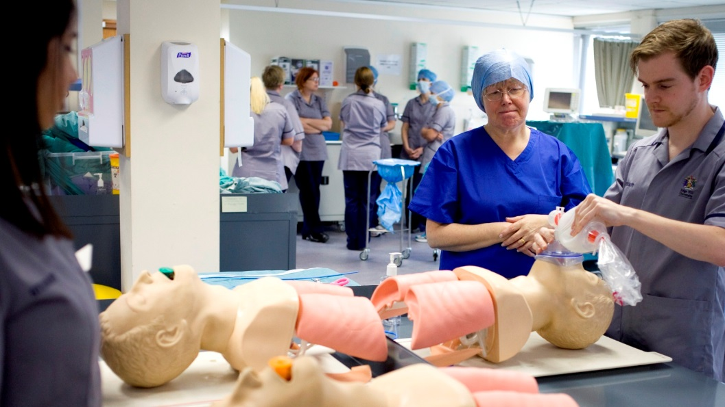
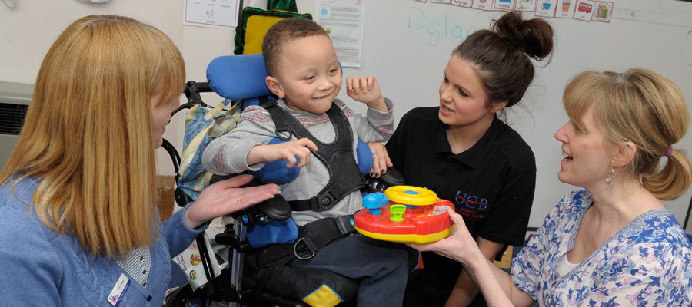
Health and Social Care Overview
BTEC Level 3: Extended Certificate in Health and Social care:
What will I be studying?
The learning programme covers the following content areas:-
• Human lifespan development
• Working in Health and Social care
• Meeting individual care and support plans
• Supporting individuals with additional needs

Slide 5
Health and Social Care Overview
BTEC Level 3: Extended Certificate in Health and Social care:
The optional units have been designed to support choices in progression to Health and Social care courses in higher education and to link with relevant occupational areas:-
• Care workers (child and adult)
• Doctors
• Midwives
• Social workers
And many more?

Slide 6
Health and Social Care Overview
BTEC Level 3: Extended Certificate in Health and Social care:
What skills will I learn?
• Cognitive and problem-solving skills: use critical thinking, approach non-routine problems applying expert and creative solutions, use systems and technology.
• Intrapersonal skills: communicating, working collaboratively, negotiating and influencing, self-presentation.
• Interpersonal skills: self-management, adaptability and resilience, self-monitoring and development.

Slide 7
Health and Social Care Overview
BTEC Level 3: Extended Certificate in Health and Social care:
Course structure:
 | Term 1 |  | Term 2 | Term 3
Year 1 | Unit 2 |  |  | Unit 2 exam revision and exam
 | Unit 1 |  |  | Unit 5
Year 2 | Unit 5 | Unit 12 |  | Unit 2 revision and exam
 | Unit 1 & Unit 2 revision

Slide 9
HSC challenge 1
Now you have learned that HSC is made up of lots of different roles and responsibilities. I would like you to try one of the following 2 challenges then email me your outcomes so I can see what you have been up to. Good luck!
Challenge 1 – Job roles. Produce a detailed brainstorm on all the different possible job roles in HSC. Think about the different people you may of met in your such as doctors etc. Create a clear poster that can be displayed in the classroom

Slide 10
HSC challenge 2
The second challenge will look at your research skills.
Using the life stages: infancy, early childhood and adolescence… Write a short description about your development so far.
Write a prediction on how you think your development will progress…
Research PIES- what does it stand for?
Write a definition for each of the 4 areas of development.
Look up the following definitions:
Growth development
Developmental norms
Developmental milestones
Life course
Maturation
Life expectancy.

Slide 11
If you have any further questions please email the course leader Name: Miss North Email address: amynorth@darlaston.graceacademy.org.uk

