Slide 2
Overview of BTEC Level 3 Extended Certificate in Sport
You need complete 4 units by the end of the course to be awarded at least a PASS. This is a 2 year course.
Optional unit:
2022-2023 Coursework Practical Sports Performance or Sports Leadership
Unit 1: Exam
May 2022 Anatomy and Physiology
2 retakes only
Unit 2: Exam May 2022 Fitness Training and Programming for Health, Sport and Well-Being
2 retakes only
Unit 3:
2022-2023 Coursework Professional Development in the Sports Industry

Slide 3
Unit 1
Unit 1 - Anatomy and Physiology.
You will look at 5 systems and learn now they work and what are the short term and long term adaptations for each system.
Skeletal system (bones)
Muscular system (muscles)
Respiratory system (how we breathe)
Cardiovascular system (heart)
Energy System (how we produce energy)
The exam is 1 hour 30 minutes and consists of 1, 2 ,3 4 and 6 mark questions and one 8 mark question.
You will take this exam in May 2022 (Year 12) with 2 further resits in Jan 2023 (Year 13) and May 2023 (Year 13)

Slide 4
Unit 2
Unit 2 - Fitness Training and Programming for Health, Sport and Well-Being.
Examine lifestyle factors and their effect on health and well being
Understand the screening processes for training programming
Understand programme-related nutritional needs
Examine training methods for different components of fitness
Principles of training and programming.
About the exam
The exam takes place in May 2022 (Year 12) and 2 further resits will take place in Jan 2023 (Year 13) and May 2023 (Year 13)
About 2 weeks before the exam you will be given PART A of the exam booklet.
You will then have a maximum of 4 hours to conduct your own research
And make notes to a maximum of 4 sides of A4 (font size 11) to take in with you to the exam
Teachers cannot support the taking of these notes
The exam is 2 hours 30 minutes.

Slide 5
Unit 3 and 4
Unit 3 - Professional Development in the Sports Industry
Unit 4 – Sports Leadership.
Both of these units are internally assessed unit which means you will complete a series of written assignments to meet the criteria of each assignment.
You will be given deadlines for each assignment and allowed to re-submit this assignment once.

Slide 6
In your groups answer the true or false quiz on your table.
P
True or False?
P

Slide 7
True or false? – ACTIVITY 1
1. The adult human body has 206 bones.
2. A child's body consists of 184 bones.
3. Bones function as the skeleton of the human body, allow body parts to move and protect organs from impact damage. They also produce red and white blood cells.
4. The human hand, including the wrist, contains 54 bones.
5. The Humerus, in the upper arm, is the longest and strongest bone of the human skeleton. True or false?
6. The stapes, in the middle ear, is the smallest and lightest bone of the human skeleton.
7. Bones are made up of calcium, phosphorus, sodium, and other minerals, as well as the protein collagen.
8. The collarbone is the most commonly broken bone among children.
9. Bones stop growing in length at the age of 25 years old.
10. Tendons attach bones to other bones.

Slide 8
Answers
1. The adult human body has 206 bones. True
2. A child's body consists of 184 bones. False – we actually have 270 bones as a child.
3. Bones function as the skeleton of the human body, allow body parts to move and protect organs from impact damage. They also produce red and white blood cells. True
4. The human hand, including the wrist, contains 54 bones. True
5. The Humerus, in the upper arm, is the longest and strongest bone of the human skeleton. True or false? False – it is actually the Femur in the leg.
6. The stapes, in the middle ear, is the smallest and lightest bone of the human skeleton. True
7. Bones are made up of calcium, phosphorus, sodium, and other minerals, as well as the protein collagen. True
8. The collarbone is the most commonly broken bone among children. True
9. Bones stop growing in length at the age of 25 years old. False – they stop growing during puberty.
10. Tendons attach bones to other bones? False – it is actually ligaments that attach bones to bone

Slide 9
Activity 2
Humerus
Carpals
Radius
Ulna
Patella
Cranium
Clavicle
Pelvis
Tibia
Fibula
Tarsals
Metatarsals
Phalanges
Scapula
Ribs
Sternum
Metacarpals
Phalanges
Femur
Vertebral Column = Cervical/Thoracic/Lumbar/ Sacral/ Coccygeal
Have a go at labelling the correct bones from the list opposite.

Slide 10
How many did you get right?
Check on the next page?

Slide 11
Skull
Sternum
Clavicle
Scapula
Ribs
Humerus
Radius
Pelvis
Ulna
Metacarpals
Carpals
Vertebral column
Phalanges
Patella
Femur
Fibula
Metatarsals
Tibia
Tarsals
Phalanges

Slide 12
Research the postural deviations and create a poster.

Slide 13
Have a go at labelling these muscles on a diagram.
Deltoids,
biceps,
triceps,
wrist flexors,
wrist extensors,
supinators and pronators,
pectorals,
abdominals,
obliques,
quadriceps,
hip flexors,
tibialis anterior,
erector spinae,
trapezius,
latissimus dorsi,
gluteals,
hamstrings,
gastrocnemius,
soleus

Slide 14
How many did you get right?
Check on the next page?

Slide 15
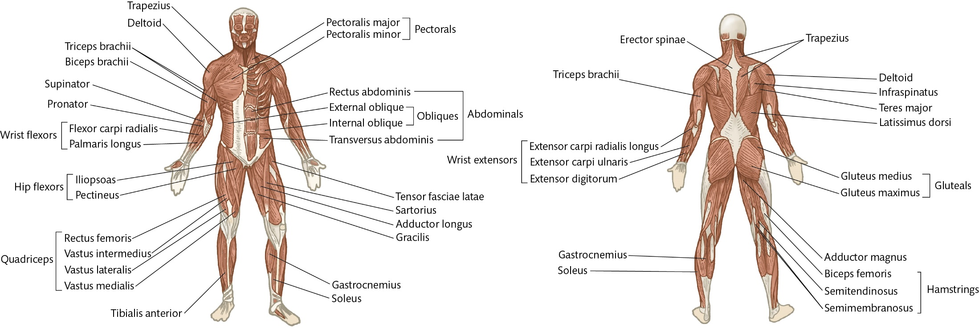
Front view

Slide 16
Back view

Slide 17
Any questions?
sbiddlecombe@darlaston.graceacademy.org.uk

